Slide 1


Retinal blood vessel segmentation in eyes fundus images
Marawan Elbatel
Kazi Saaed Alam
José Carlos Reyes Hernández
University of Burgundy
Image Processing
Januray 10th, 2022. Le Creusot, France

Slide 2

Overview
Introduction
Preliminary concepts
Methodology
Results & Discussion
Demo
References

Slide 3
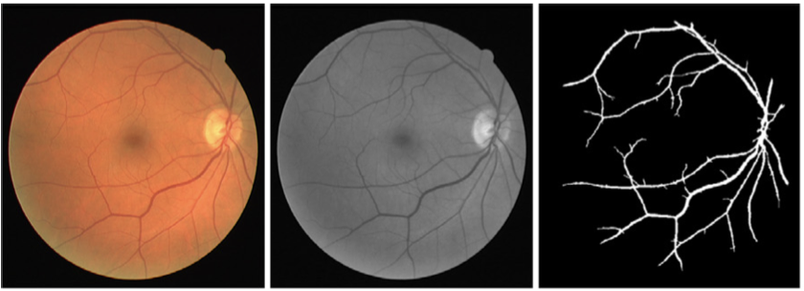
Introduction
The retina: non-invasive method for the detection of systematic diseases.
Morphological information through segmentation.
Challenges: diversity of vessels, shape, size, intensity of pixels..
A procedure to segment thin and thick retinal vessels is essential for medical analysis and diagnosis of related diseases
Segmentation of the eye fundus. Ramos Soto et al, 2021.

Slide 4
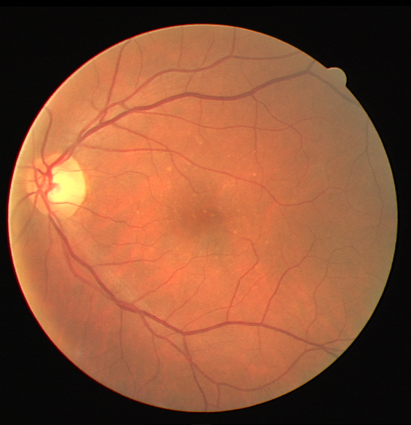
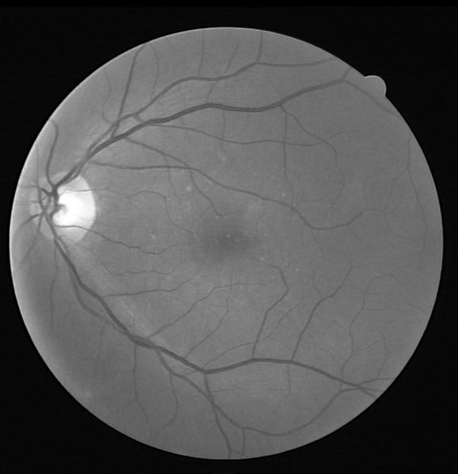
Preliminary Concepts: Green Channel Extraction
The original eye fundus image is provided in RGB format
By performing an analysis of each separate channel, the green channel shows a great vessel-background contrast
The human eye maintains a better perception of the green channel.
Input Image
Green Channel

Slide 5
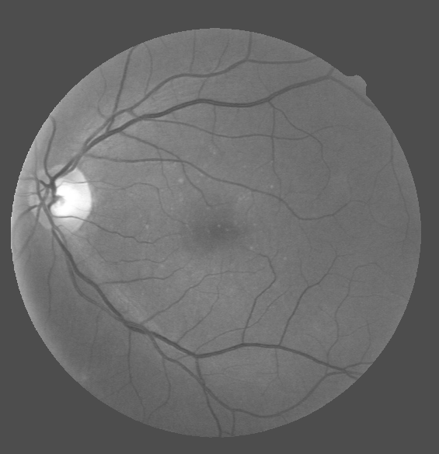
Preliminary Concepts: Black Ring Removal
A background with a high level of homogeneity is necessary to obtain better results for further steps.
The black background around the retina is removed from the grayscale image to provide uniformity in the image.
Each black pixel is replaced with an intensity level equivalent to the average value within the retinal image.
Green Channel
After Black Ring Removal

Slide 6
Preliminary Concepts: Homomorphic Filtering
To normalize the brightness across the image and increase the contrast, We have applied homomorphic filtering.
Uses the concept of illumination-reflectance model.
Illumination being the primary contributor of the dynamic range of the image varies slowly in space.
Reflectance being the representative of edge details varies very rapidly in space.
The idea is to separate these two components and apply different transformation function to gain more control in the image.
Gaussian filter is used in the frequency domain with σ value=2 to enhance to enhance the vessels as they have high reflectance frequency.

Slide 7
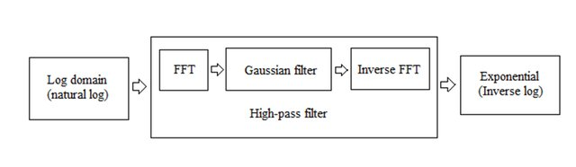
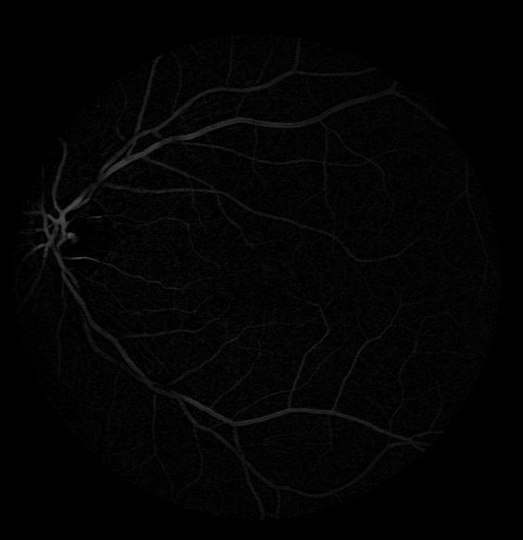
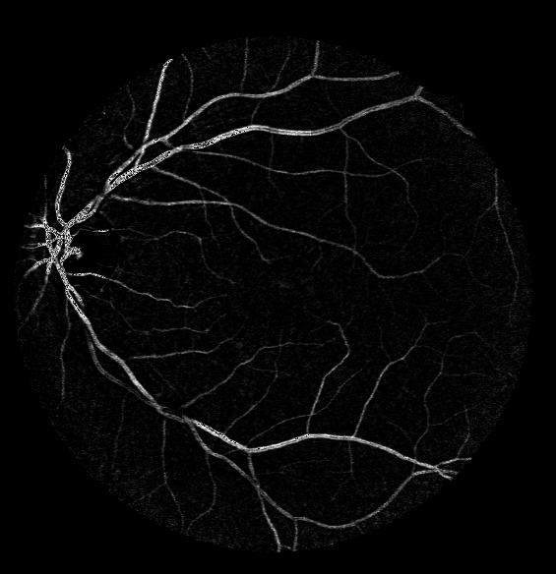
Preliminary Concepts: Homomorphic Filtering(cont.)
Steps for Homomorphic Filtering:
Bottom-Hat Image
Homomorphic Filtered Image

Slide 8

Preliminary Concepts: Median Filtering
Salt and pepper noise generated by the homomorphic filtering process is removed by a median filter process.
The principal feature to highlight is that the median filter preserves edges while removing noise.
Median Filter performs very good to remove these noises from the images.
The size of the kernel is a [3,3] matrix.
Homomorphic Filtered Image
Median Filtered Image

Slide 9
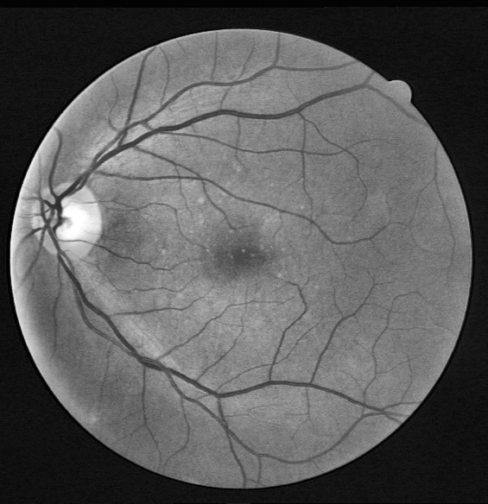
Preliminary Concepts: CLAHE contrast Enhancement
Contrast limited adaptive histogram equalization.
Regular histogram equalization uses the global contrast to stretch it.
The image is divided into smaller tiles(usually 8*8) and then at each tiles, histogram equalization is performed.
To avoid the amplification of noise, contrast or clip limit is applied.
At edges, CLAHE applies bilinear interpolation to get the pixel information.
Black Ring Removed
CLAHE Applied

Slide 10
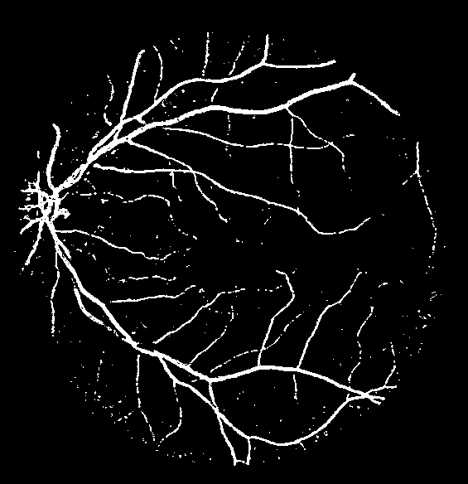
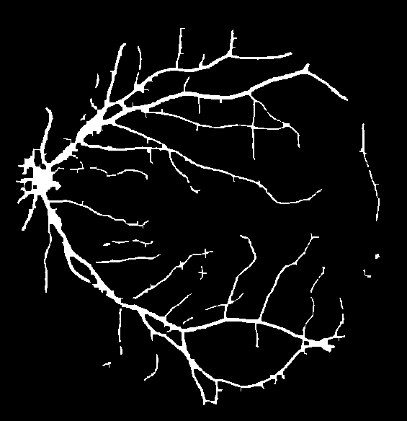
Preliminary Concepts: Postprocessing (Morphological Operations)
Postprocessing operations is performed by using morphological operations such as closing and opening.
These operations allow removing not connected structures considering as noise.
Also rebuild those elements considered as a part of vessel
MCET-HHO image
Final Image(Method-1)

Slide 11
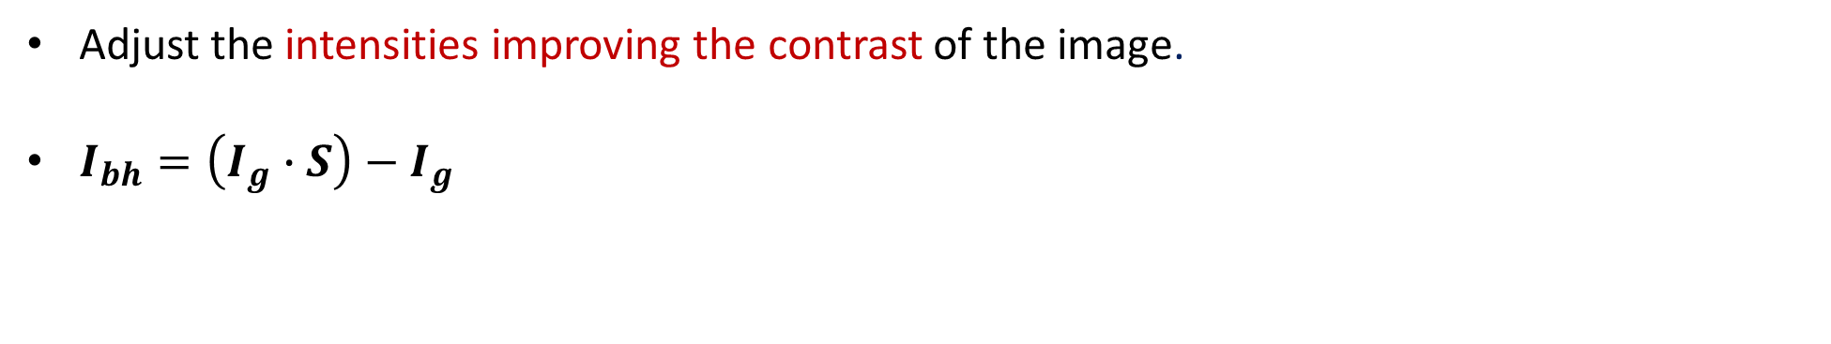
Preliminary Concepts: Bottom-Hat Transformation
Adjust the intensities improving the contrast of the image.
$I_{bh}=\left(I_{g}∙S\right)−$ $I_{g}$
Black Ring Removed
Bottom Hat Image

Slide 12
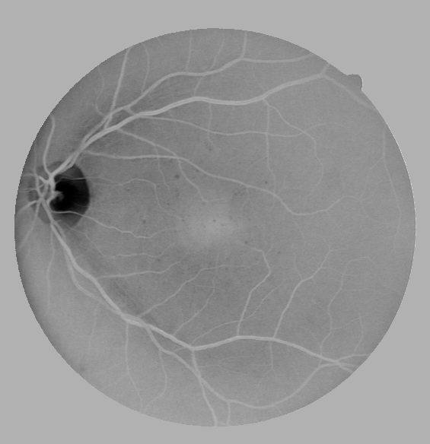
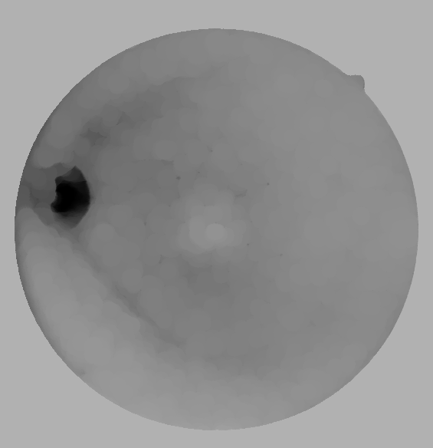
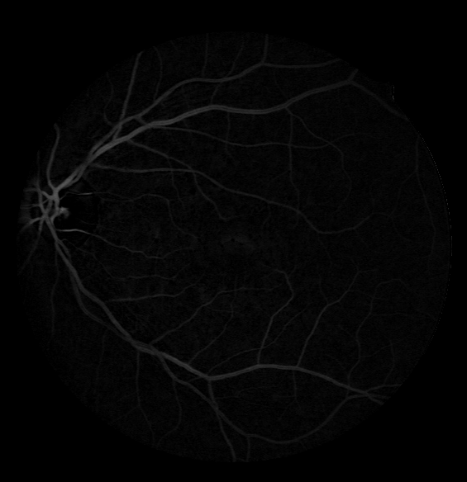
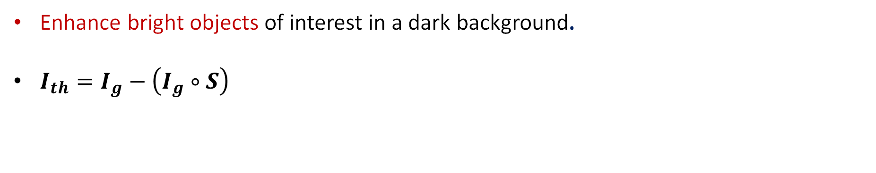
Top Hat Transformation
Enhance bright objects of interest in a dark background.
$I_{th}=I_{g}−\left(I_{g}∘S\right)$
Image Complement
Opened Image
Top Hat Image

Slide 13
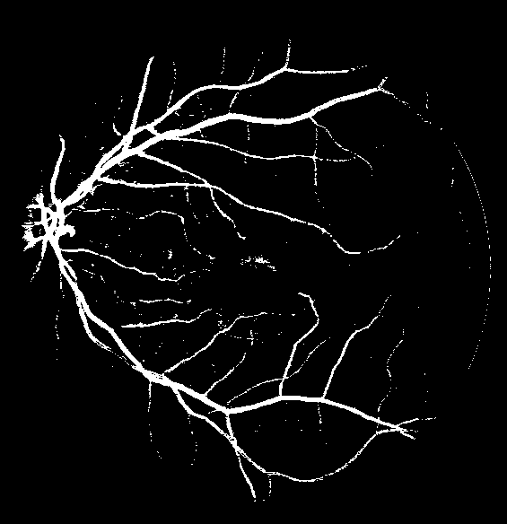
OTSU Thresholding
Find the threshold value where the spread value is the least.
OTSU
Top Hat Image
Thresholded Image

Slide 14
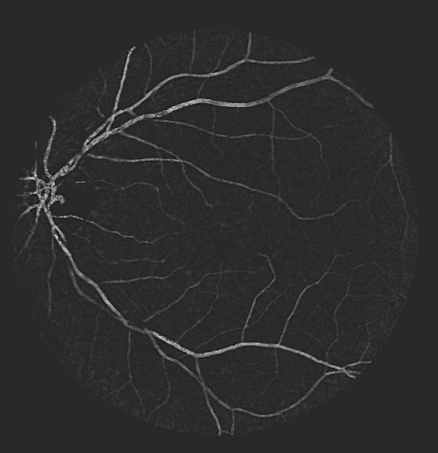
Preliminary concepts: Lateral inhibition
Active receptor to decrease the activity of its neighbour.
Pixels= receptors; Gray values= activation levels.
Pixels differences in regions of high contrast
Median Filtered Image
After Lateral Inhibition

Slide 15
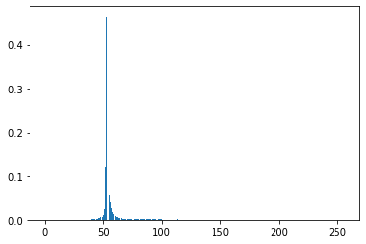
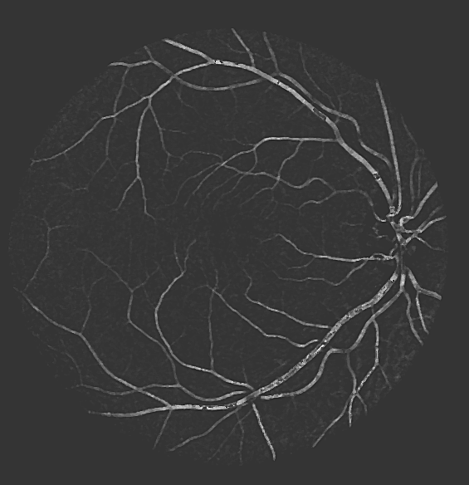
Preliminary Concepts: MCET-HHO
Sample image histogram.
hist

Slide 16
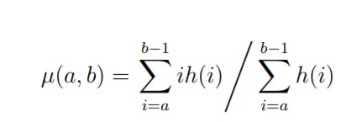
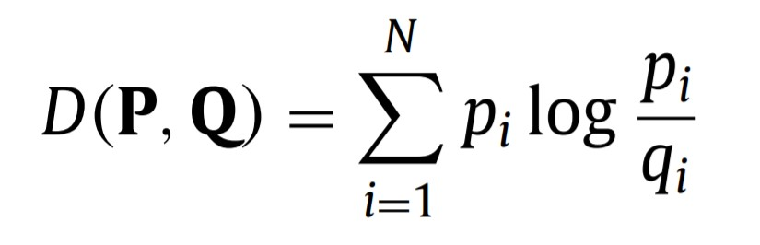
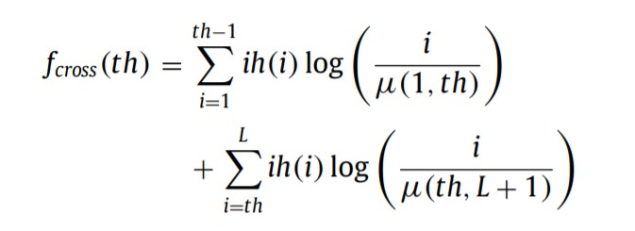
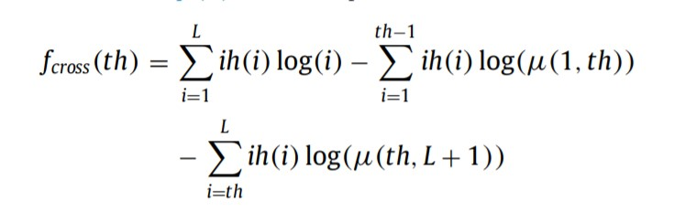
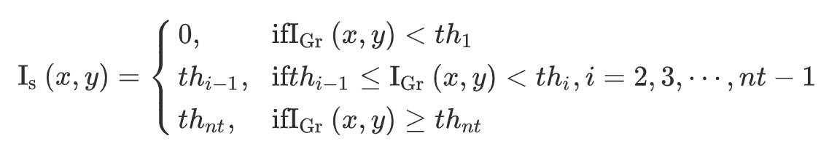
Preliminary Concepts: MCET-HHO
Minimum Cross Entropy with Harris Hawks Optimization
Eq. 2
Eq. 1
Cross-Entropy
Mean
Eq. 3
Eq. 4
Cross-Entropy Value
Optimized Rewriting
Eq. 5
Segmented Image

Slide 17
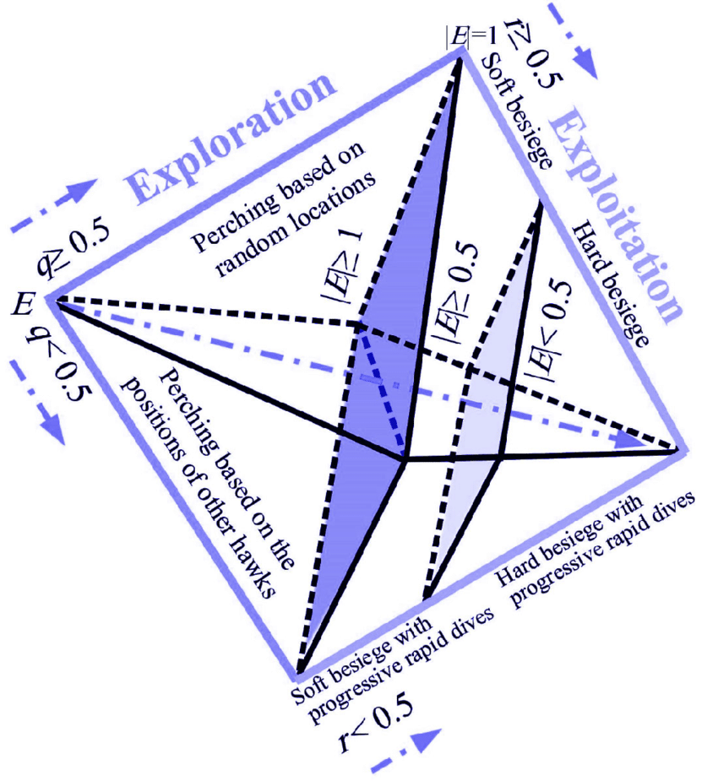
Preliminary Concepts: MCET-HHO
Harris Hawks Optimization

Slide 18
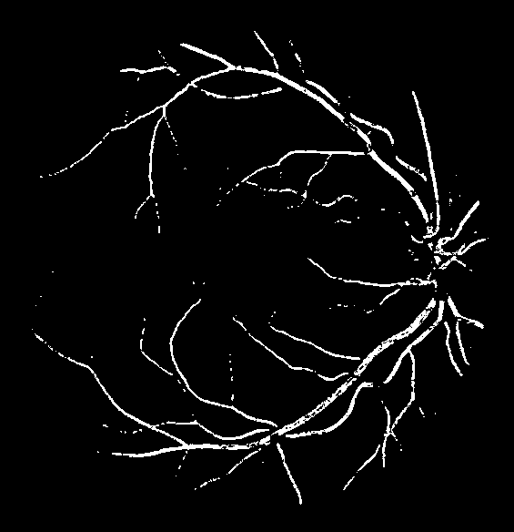
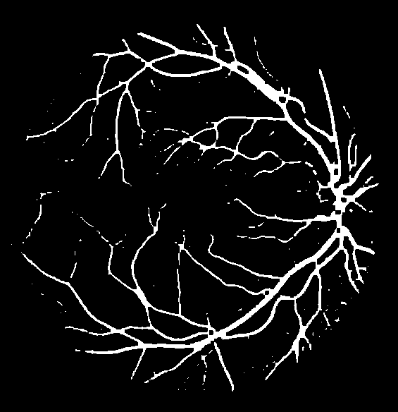
Preliminary Concepts: MCET-HHO
T1=89
OTSU
T=[73, 131, 248]
MCET-HHO
After Preprocessing Steps

Slide 19
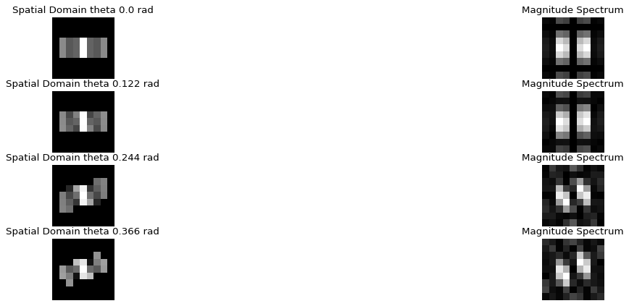
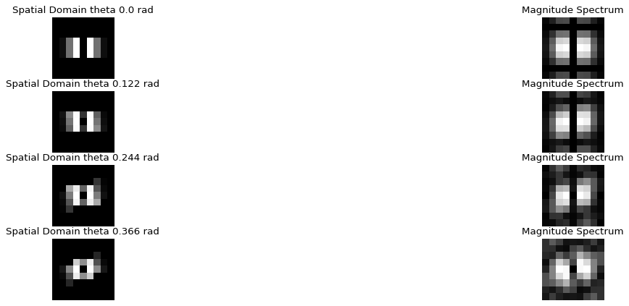
Preliminary Concepts: 2D Matched Filtering
Signal assumed gaussian.
Sample Matched Filters Used
Sample Gaussian Derivative Filters

Slide 20
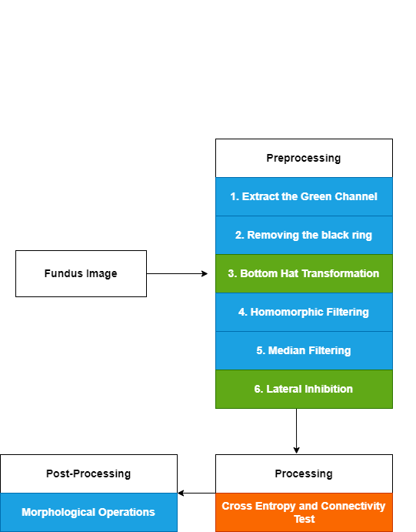
Methodology: Hybrid Method
Saeed
Marwan
José

Slide 21
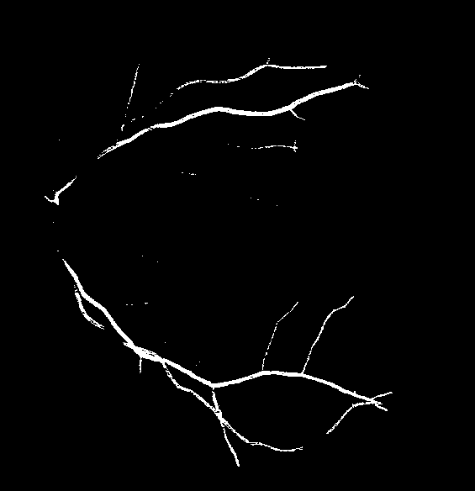


Thick Vessel Processing
Distance Threshold
Top Hat Image
+
Cleaned
Thick Vessels
Thresholded Image

Slide 22
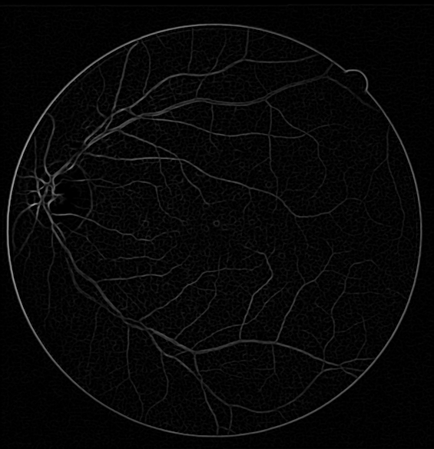
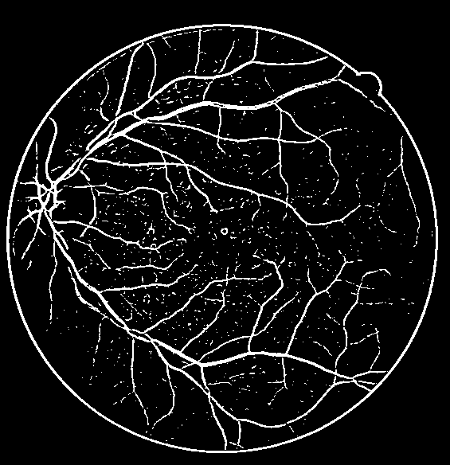

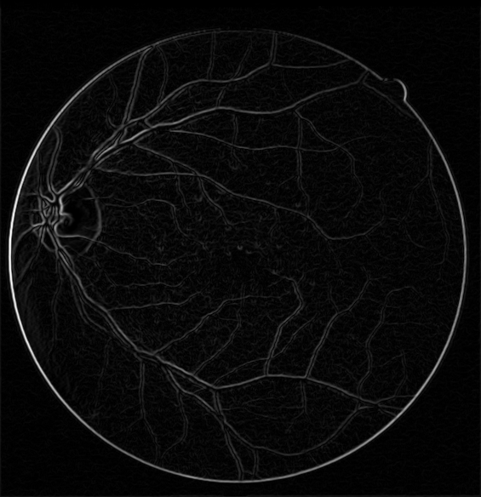
Thin Vessel Processing
Matched Filter
>=
Clahe Image
Thin Vessels
Blurred
Clahe Gaussian Derivative

Slide 23
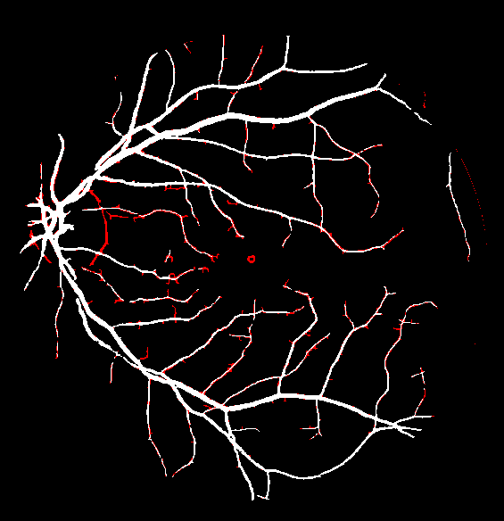
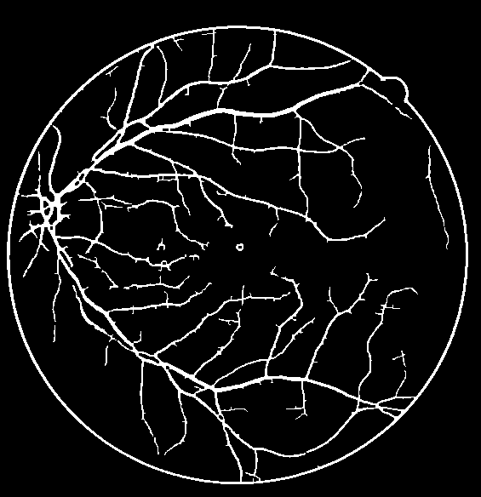
Methodology: Farzaneh Koohestani
Combine
Thick Vessels
Predicted Image
Thin Vessels

Slide 24
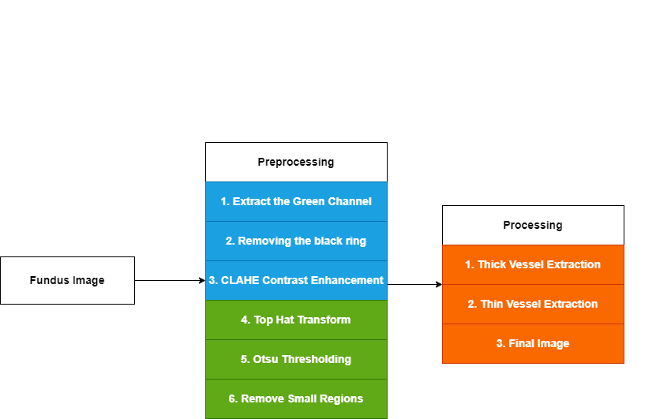
Methodology: Farzaneh Koohestani
Saeed
Marwan
José

Slide 25
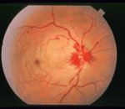
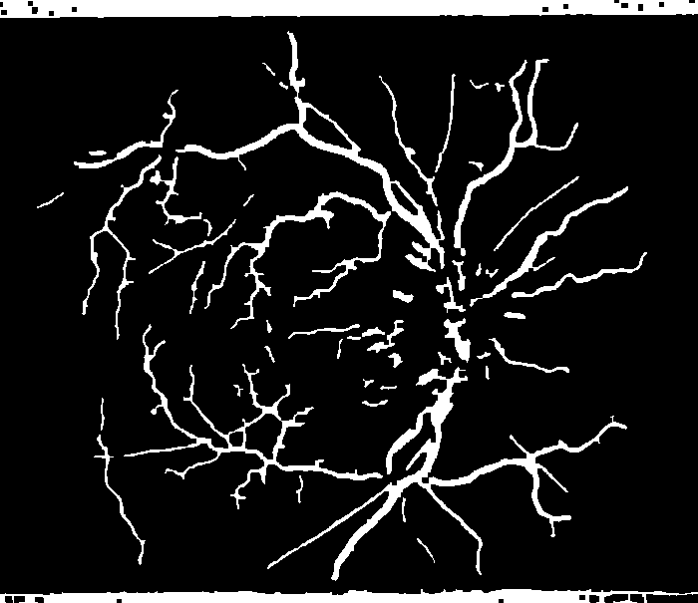
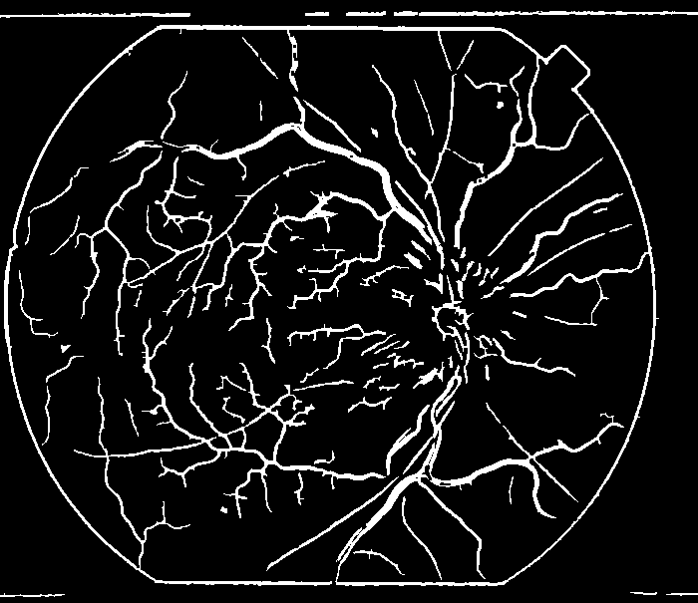
Results & Discussions
On Training Data:
On Test Data:
Method | Dataset | Specificity | Sensitivity | Accuracy | Dice
Method-1 (Diaz) | DRIVE | 0.982472 | 0.619957 | 0.950721 | 0.689531
Method-1 (Diaz) | STARE | 0.965026 | 0.535553 | 0.937838 | 0.547164
Method-2 (Farkoo) | DRIVE | 0.983454 | 0.680741 | 0.95684 | 0.730711
Method-2 (Farkoo) | STARE | 0.965026 | 0.57662 | 0.935589 | 0.567613
Method | Dice Mean Score
Method-1 (Diaz) | 0.712295
Method-2 (Farkoo) | 0.756445
Sample Stare
Diaz
Farkoo​

Slide 26
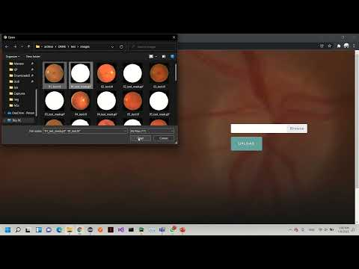
DEMO

Slide 27
Thank you!

Slide 28
References
[1] Oscar Ramos-Soto, Erick Rodríguez-Esparza, Sandra E. Balderas-Mata, Diego Oliva, Aboul Ella Hassanien, Ratheesh K. Meleppat, Robert J. Zawadzki, An efficient retinal blood vessel segmentation in eye fundus images by using optimized top-hat and homomorphic filtering, Computer Methods and Programs in Biomedicine, Volume 201, 2021,
[2] Díaz Primitivo, Rodríguez Alma, Cuevas Erik, Valdivia Arturo, Chavolla Edgar, Pérez-Cisneros Marco, Zaldívar Daniel, A hybrid method for blood vessel segmentation in images, Biocybernetics and Biomedical Engineering, Volume 39, Issue 3, 2019,
[3] Zhang J, Li H, Nie Q, Cheng L. A retinal vessel boundary tracking method based on Bayesian theory and multi-scale line detection. Comput Med Imaging Graph 2014;38(6):517–25.
[4] Zhang Y, Hsu W, Lee ML. Detection of Retinal Blood Vessels Based on Nonlinear Projections. J Signal Process Syst 2009;55(1–3):103–12.
[5] Khdhair N, Abbadi E, Hamood E, Saadi A. Blood vessels extraction using mathematical morphology. J Comput Sci Publ Online 2013;9(910):1389–95.
[6] Hassan G, El-Bendary N, Hassanien AE, Fahmy A, Shoeb AM, Snasel V, et al. Retinal blood vessel segmentation approach based on mathematical morphology. Procedia Comput Sci 2015;65:612–22.
[7] Kumar D, Pramanik A, Kar SS, Maity SP. Retinal blood vessel segmentation using matched filter and Laplacian of Gaussian. 2016 International Conference on Signal Processing and Communications (SPCOM). 2016;1–5.
[8] Zhang B, Zhang L, Zhang L, Karray F. Retinal vessel extraction by matched filter with first-order derivative of Gaussian. Comput Biol Med 2010;40(4):438–45.
[9] Ben Abdallah M, et al. Automatic extraction of blood vessels in the retinal vascular tree using multiscale medialness. Int J Biomed Imaging 2015;2015.
[10] Almotiri J, Elleithy K, Elleithy A. A multi-anatomical retinal structure segmentation system for automatic eye screening using morphological adaptive fuzzy thresholding. IEEE J Transl Eng Heal Med 2018;6:1–23.
[11] Ryu H, Moon H, Browatzki B, Wallraven C. Retinal vessel detection using deep learning: a novel directnet architecture. Korean J Vis Sci 2018;20(2):151–9.
[12] Oliveira A, Pereira S, Silva CA. Retinal vessel segmentation based on fully convolutional neural networks. Expert Syst Appl 2018;112:229–42.
[13] Kaur J, Mittal D. A generalized method for the detection of vascular structure in pathological retinal images. Biocybern Biomed Eng 2017;37(1):184–200.

